Slide 1

COMPUTER NETWORKS
(BCSC 0008)
Copyright content, use only with the written permission of presenter mentioned
Lecture 4

Slide 2
Text and Reference Books
Text Books:
Fourouzan B. A. (2004), “Data Communication and Networking”, 4th Edition, McGraw-Hill.
References:
Kurose, J. F. and Ross K. W. (2005), “Computer Networking: A Top-Down Approach Featuring the Internet”, 3rd Edition, Addison-Wesley.
A. S. Tanenbaum (2006), “Computer Networks”, 2nd Edition, Prentice Hall India.

Slide 3
Previous discussed topics:
  Communication
  Network
  Point to Point Connection
  Multipoint Connection
Now we will discuss:
  Categories of Network
  Simplex, Half Duplex, Full Duplex Network
  Topology : Bus, Star, Ring, Mesh, Hybrid

Slide 4
So, How many Kinds of Network??
Based on Transmission Media
Based on Network Size
Based on Management Method
Based on topology (Connectivity)
Based on Data Flow Direction
Wired (UTP, Coaxial, fiber optic) or Wireless (Air, Water)
LAN, MAN and WAN
Peer to Peer and Client Server
Bus, Star, Ring, Mesh, Hybrid
Simplex, Half Duplex, Full Duplex

Slide 5
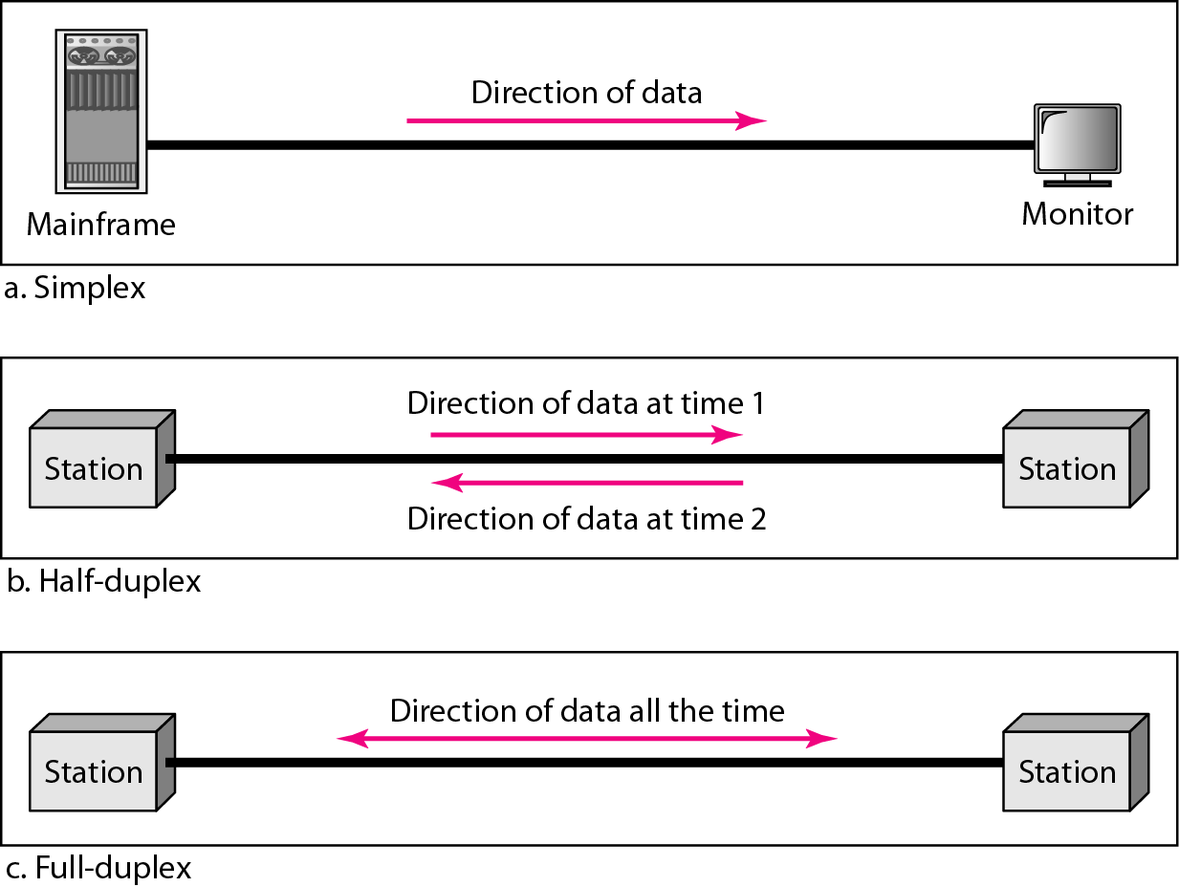
Based on Data Flow Direction
Simplex ( Always Unidirectional)
One device permanent sender and other permanent receiver. For example Computer-Printer, Computer-Speaker
Half Duplex ( Bidirectional but any particular time unidirectional)
The role of devices may vary with respect to time [Both cannot be in same role at any time]. For example Walkie-Talkie
Full Duplex or Duplex ( Bidirectional Always)
Both devices may or may not be in the same role at any time. For example Telephone or Cellular

Slide 6
Based on Topology (Connectivity)
Bus (can be both logical and physical)
Star (physical only)
Ring (can be both logical and physical)
Mesh (can be both logical and physical)
A topology is a way of “laying out” the network. Topologies can be either physical or logical.
Physical topologies describe how the cables are run (Appearance)
Logical topologies describe how the network messages travel (Behavior)
Physical topologies
  Bus
  Star
  Ring
  Mesh
  Hybrid
Logical topologies
  Bus- Ring
  Star-Ring
  Mesh-Ring

Slide 7
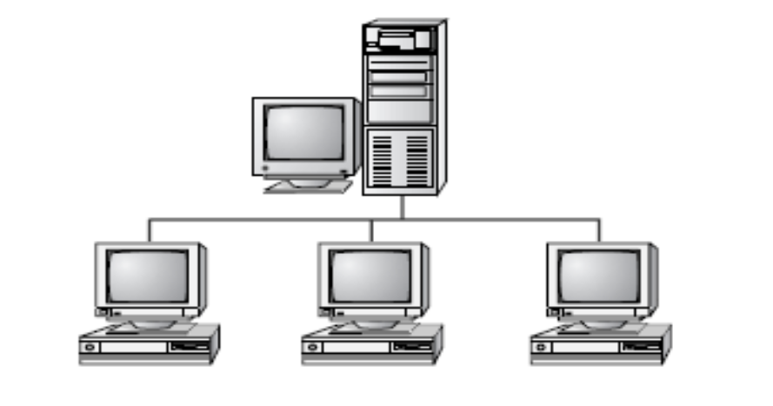
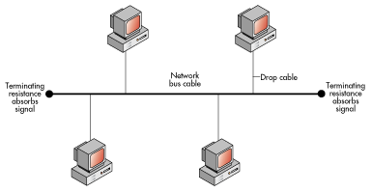
BUS Topology
A bus is the simplest physical topology. It consists of a single cable that runs to every device.
This topology uses the least amount of cabling, but also covers the shortest amount of distance.
In a bus topology, signals are broadcast to all stations
When Signal is passed to all the station , it is termed as broadcast
Multipoint Connection
Then according to broadcast, the packet must be received and accessed by all ??
No, Why ??

Slide 8
BUS Topology
Each computer checks the address on the signal (data frame) as it passes along the bus.
If the signal’s address matches that of the computer, the computer accepts the signal.
If the address doesn’t match, the computer takes no action and the signal travels on down the bus.
Multipoint Connection

Slide 9
BUS Topology
Advantages
Cheapest topology
Only 1 cable is associated with all devices.
Less complex network
  Failure of one station does not affect others
Disadvantages
If main cable breaks, the whole system shuts.
  Limited cable length and number of stations
Only one device can transmit (send) data (signal) at any time.

Slide 10
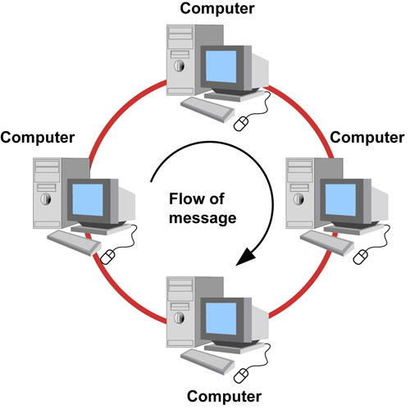
RING Topology
Each computer connects to two other computers, joining them in a circle creating a unidirectional path where messages move device to device.
Each entity participating in the ring reads a message, then regenerates it (serves as a repeater) and hands it to its neighbor on a different network cable.
“n” cables required for “n” devices
Point to Point Connection

Slide 11
RING Topology
Advantages
Data is quickly transferred without a ‘bottle neck’. (very fast, all data traffic is in the same direction)
The transmission of data is relatively simple as packets travel in one direction only
Adding additional nodes has very little impact on bandwidth
Disadvantages
Data packets must pass through every computer between the sender and recipient therefore this makes it slower.
If any of the nodes fail then the ring is broken and data cannot be transmitted successfully.
In order for all computers to communicate with each other, all computers must be turned on.

Slide 12
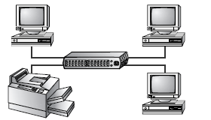
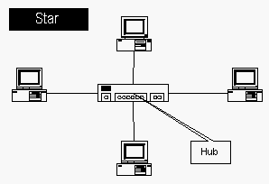
STAR Topology
All of the stations in a star topology are connected to a central unit called a hub.
If a cable is cut, it only affects the computer that was attached to it. This eliminates the single point of failure problem associated with the bus topology. (Unless, of course, the hub itself goes down.)
Star topologies are easy to install. A cable is run from each workstation to the hub.
Point to Point Connection

Slide 13
STAR Topology
Star topologies are normally implemented using twisted pair cable, specifically unshielded twisted pair (UTP).
Star topologies are more expensive to install than bus networks, because there are several more cables that need to be installed, plus the cost of the hubs that are needed.
‘n’ cables are required for ‘n+1’ devices
Advantages of star topology:
  Easy to add new stations
  Easy to monitor and troubleshoot
  Failure of one station does not affect the whole system
  Disadvantages of star topology:
  Failure of hub cripples attached stations
  More cable required

Slide 14
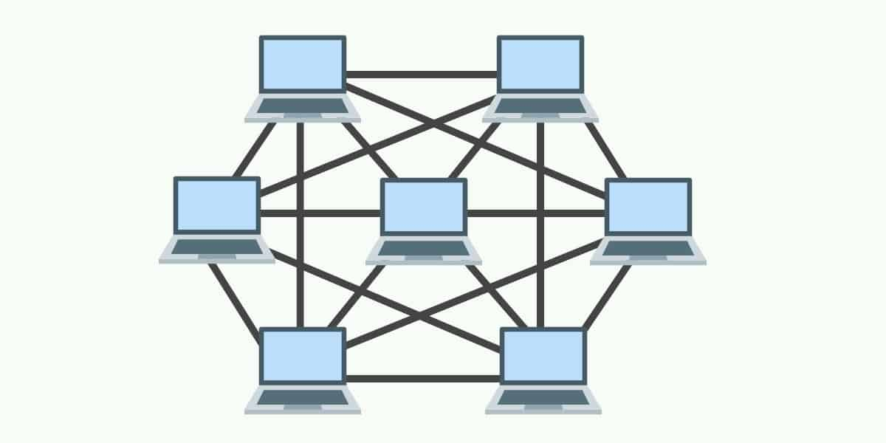
MESH Topology
Simplest logical topology in terms of data flow, but it is the most complex in terms of physical design.
In this physical topology, each device is connected to every other device
Very rare topology
For ‘n’ devices n(n-1)/2 cables required
The only advantage is high fault tolerance.

Slide 15
Thank You
Discussion & Doubt session will be in lecture.
Important terms to keep in mind
  Categories of Network
  Simplex, Half Duplex and Duplex network
  Bus, Ring, Star, Mesh topology

